Slide 2
Question 123.11.1
You open your freezer (or a door in January in Rexburg), does energy flow out, or does cold flow in?
Cold in
Energy out

Slide 3
Question 123.11.2
You use Joule’s paddle apparatus to raise the temperature of a fluid. Is any heat involved?
Yes
No
Maybe

Slide 4
Internal Energy
Internal Energy, U, is the energy associated with the microscopic components of the system
  Includes kinetic and potential energy associated with the random translational, rotational and vibrational motion of the atoms or molecules
  Also includes any potential energy bonding the particles together
internal energy is all the energy of a system that is associated with its microscopic components -- atoms and molecules -- when viewed form a reference frame at rest with respect to the center of mass of the system.

Slide 5
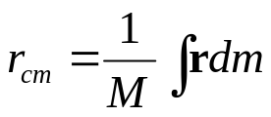
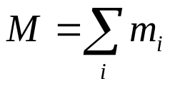


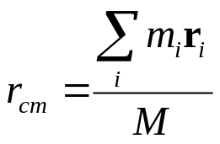
Review Center of Mass
Recall that
Where
For a group of molecules

Slide 6
Energy Transfer
When two objects of different temperatures are placed in thermal contact, the temperature of the warmer decreases and the temperature of the cooler increases
The energy exchange ceases when the objects reach thermal equilibrium
The concept of energy was broadened from just mechanical to include internal
  Made Conservation of Energy a universal law of nature

Slide 7
Heat Compared to Internal Energy
Important to distinguish between them
  They are not interchangeable
They mean very different things when used in physics

Slide 8
Heat
Heat is the transfer of energy between a system and its environment because of a temperature difference between them
  The symbol Q is used to represent the amount of energy transferred by heat between a system and its environment

Slide 9
Units of Heat
Calorie
  An historical unit, before the connection between thermodynamics and mechanics was recognized
  A calorie is the amount of energy necessary to raise the temperature of 1 g of water from 14.5° C to 15.5° C .
    A Calorie (food calorie) is 1000 cal

Slide 10
Units of Heat, cont.
US Customary Unit – BTU
BTU stands for British Thermal Unit
  A BTU is the amount of energy necessary to raise the temperature of 1 lb of water from 63° F to 64° F
1 cal = 4.186 J
  This is called the Mechanical Equivalent of Heat

Slide 11
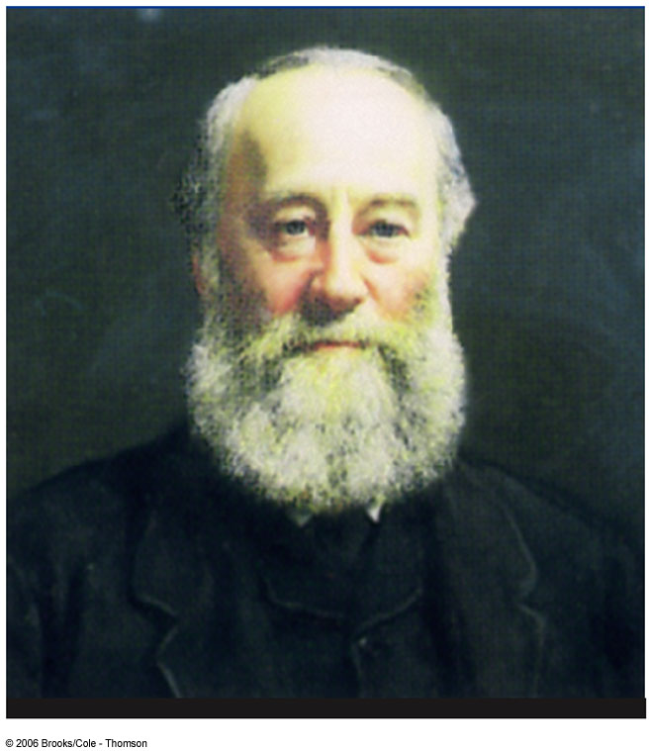
James Prescott Joule
1818 – 1889
British physicist
Conservation of Energy
Relationship between heat and other forms of energy transfer

Slide 12
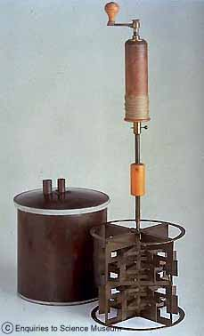
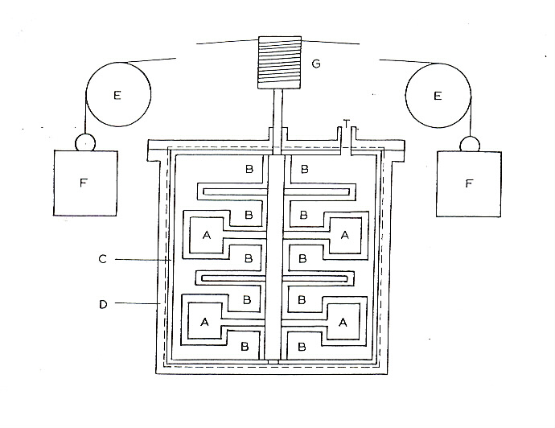
http://www.sciencemuseum.org.uk/on-line/treasure/objects/1876-492.asp

Slide 13
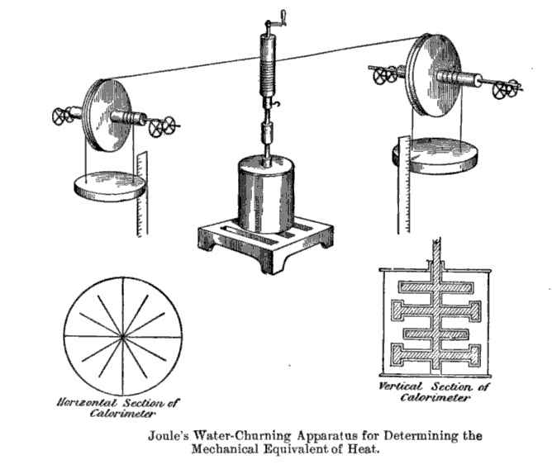

Slide 14
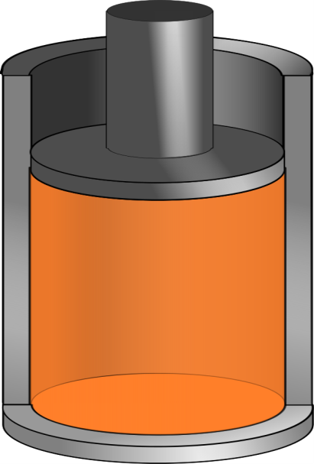
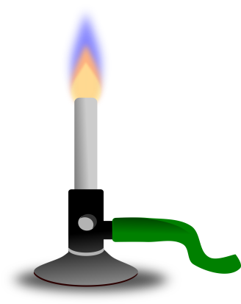
Q negative
Q positive

Slide 15
Question 123.11.3
You increase the temperature of a gas in a piston. Is there heat involved?
Yes
No
Maybe

Slide 16
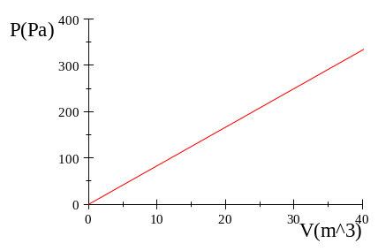
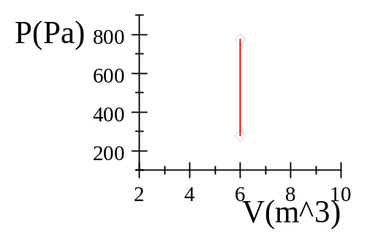
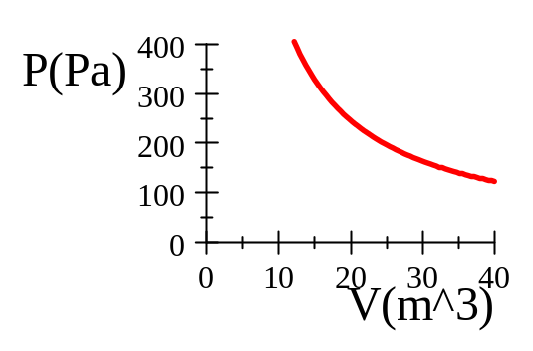
Question 123.11.6
Which graph represents an isothermal process?
A B C

Slide 17
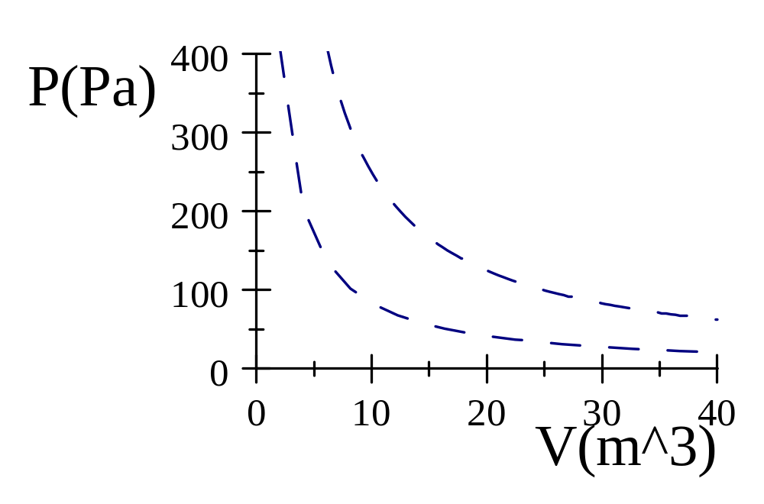
300K
100K

Slide 18
300K
100K

Slide 19
Warmer
Cooler

Slide 20
Question 123.11.4
You put a gas in a piston through a process that changes the temperature. Can Q=0?
Yes, if it is the right process
No
Maybe

Slide 21
Question 123.11.5
Which quantity is independent of path
Q
ΔE_{int}
W
Can’t tell

Slide 22
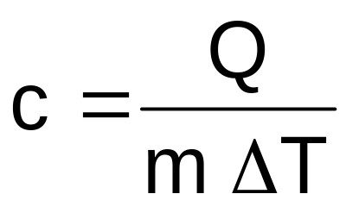
Specific Heat
Every substance requires a unique amount of energy per unit mass to change the temperature of that substance by 1° C
The specific heat, c, of a substance is a measure of this amount

Slide 23
Units of Specific Heat
SI units
  J / kg °C
Historical units
  cal / g °C

Slide 24
Heat and Specific Heat
Q = m c ΔT
ΔT is always the final temperature minus the initial temperature
When the temperature increases, ΔT and ΔQ are considered to be positive and energy flows into the system
When the temperature decreases, ΔT and ΔQ are considered to be negative and energy flows out of the system

Slide 25
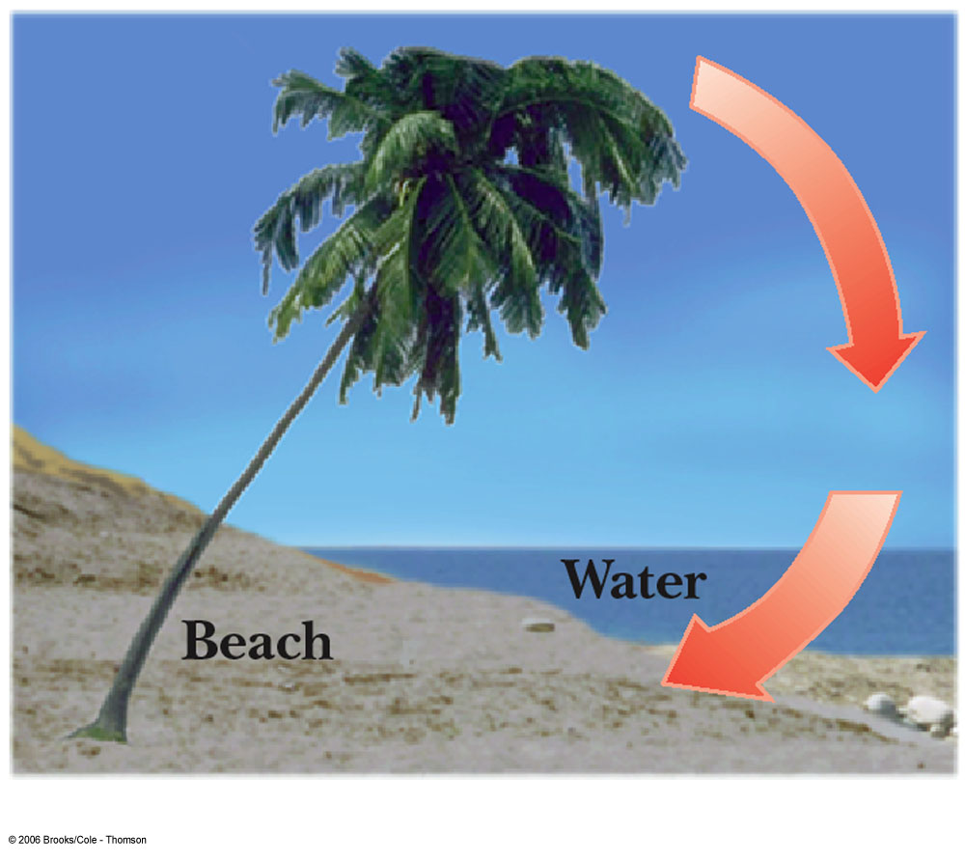
A Consequence of Different Specific Heats
Water has a high specific heat compared to land
On a hot day, the air above the land warms faster
The warmer air flows upward and cooler air moves toward the beach

Slide 26
Calorimeter
One technique for determining the specific heat of a substance
A calorimeter is a vessel that is a good insulator which allows a thermal equilibrium to be achieved between substances without any energy loss to the environment

Slide 27
Calorimetry
Analysis performed using a calorimeter
Conservation of energy applies to the isolated system
The energy that leaves the warmer substance equals the energy that enters the water
  Q_{cold} = -Q_{hot}
  Negative sign keeps consistency in the sign convention of ΔT

Slide 28
Calorimeter
Sample at known temperature T_{x}
Water temperature rises
Water at known temperature T_{w}
Insulated container

Slide 29
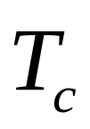
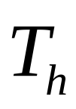
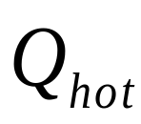
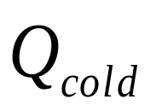
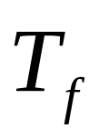
Calorimetry
Object #1
Object #2

Slide 30



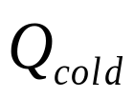
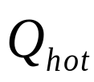
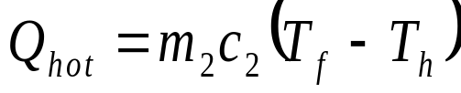


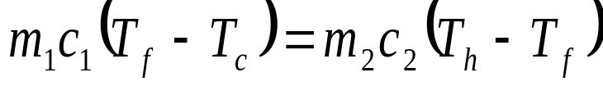
Calorimetry
Object #1
Object #2

Slide 31
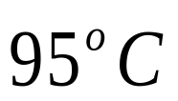

Mixture Example
200 cm³ of hot water at 95ºC is poured into a 150 g glass cup initially at 25ºC. What is the final temperature of the mixture when equilibrium is reached, assuming no heat flows to the surroundings.

Slide 32



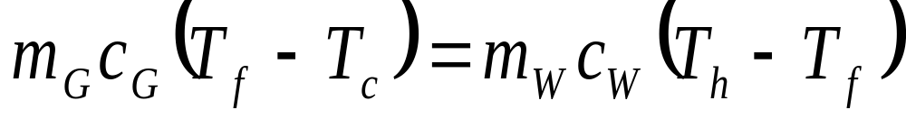
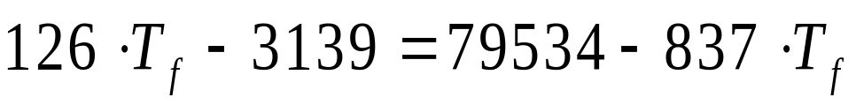
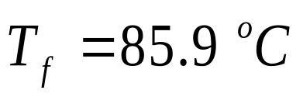
Mixture Example
200 g
What is the mass of 200 cm³ of water?

Slide 33
20.3 Latent Heat

Slide 34
Phase Changes
A phase change occurs when the physical characteristics of the substance change from one form to another
Common phases changes are
  Solid to liquid – melting
  Liquid to gas – boiling
Phases changes involve a change in the internal energy, but no change in temperature

Slide 35
Latent Heat
During a phase change, the amount of heat is given as
  Q = ±m L
L is the latent heat of the substance
  Latent means hidden
  L depends on the substance and the nature of the phase change
Choose a positive sign if you are adding energy to the system and a negative sign if energy is being removed from the system

Slide 36
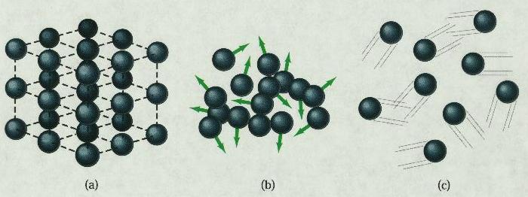
Phase Changes Latent Heat
Solid
Liquid
Gas
During a phase change, the internal energy changes but the temperature does not change.
Work is done against the attractive molecular forces to separate them.

Slide 37
Latent Heat, cont.
SI units of latent heat are J / kg
Latent heat of fusion, L_{f}, is used for melting or freezing
Latent heat of vaporization, L_{v}, is used for boiling or condensing
Table 11.2 gives the latent heats for various substances

Slide 38
Sublimation
Some substances will go directly from solid to gaseous phase
  Without passing through the liquid phase
This process is called sublimation
  There will be a latent heat of sublimation associated with this phase change

Slide 39
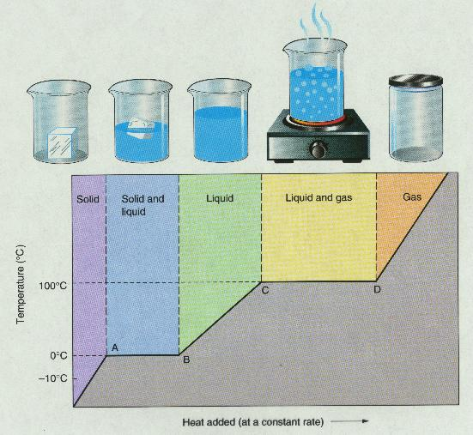
T vs. Q Graphs

Slide 40
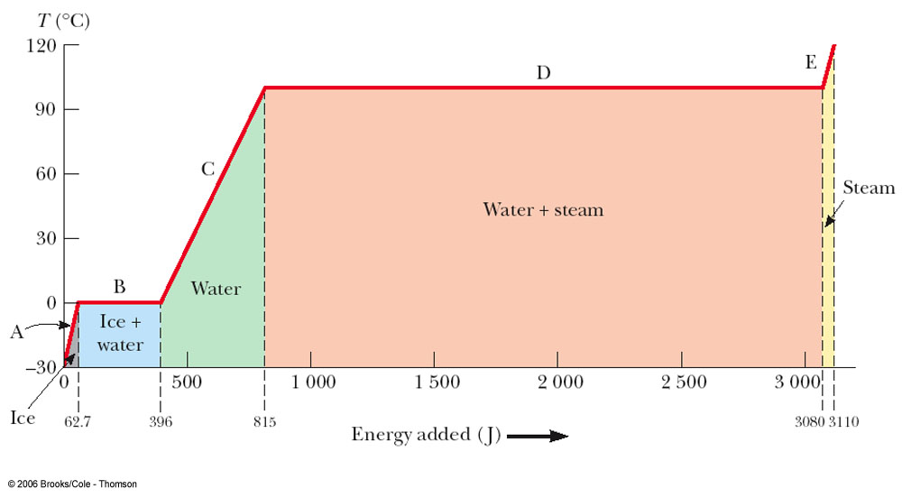
Graph of Ice to Steam

Slide 41
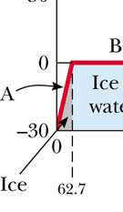
Warming Ice
Start with one gram of ice at –30.0º C
During A, the temperature of the ice changes from –30.0º C to 0º C
Use Q = m c ΔT
Will add 62.7 J of energy

Slide 42
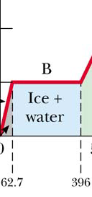
Melting Ice
Once at 0º C, the phase change (melting) starts
The temperature stays the same although energy is still being added
Use Q = m L_{f}
Needs 333 J of energy

Slide 43
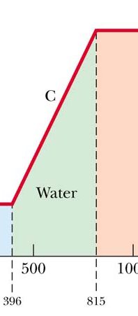
Warming Water
Between 0º C and 100º C, the material is liquid and no phase changes take place
Energy added increases the temperature
Use Q = m c ΔT
419 J of energy are added

Slide 44
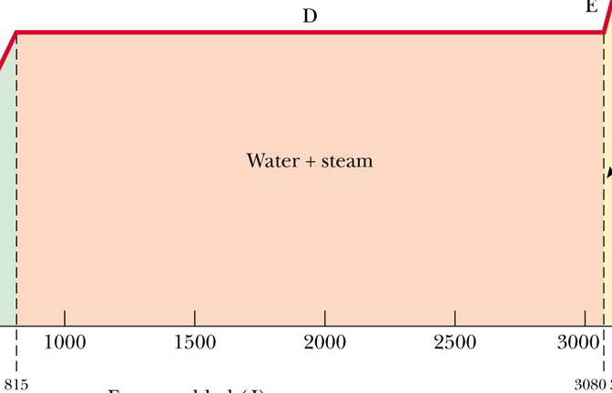
Boiling Water
At 100º C, a phase change occurs (boiling)
Temperature does not change
Use Q = m Lv
2 260 J of energy are needed

Slide 45
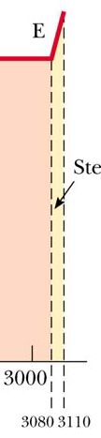
Heating Steam
After all the water is converted to steam, the steam will heat up
No phase change occurs
The added energy goes to increasing the temperature
Use Q = m c ΔT
To raise the temperature of the steam to 120°, 40.2 J of energy are needed

Slide 46
Problem Solving Strategies
Make a table
  A column for each quantity
  A row for each phase and/or phase change
  Use a final column for the combination of quantities
Use consistent units

Slide 47
Problem Solving Strategies, cont
Apply Conservation of Energy
  Transfers in energy are given as Q=mcΔT for processes with no phase changes
  Use Q = m L_{f} or Q = m L_{v} if there is a phase change
  In Q_{cold} = - Q_{hot} be careful of sign
  ΔT is T_{f} – T_{i}
Solve for the unknown

Slide 48
20.4 Work and Heat in Thermodynamic Processes

Slide 49


Work in a Gas Cylinder
The gas is contained in a cylinder with a moveable piston
The gas occupies a volume V and exerts pressure P on the walls of the cylinder and on the piston

Slide 50
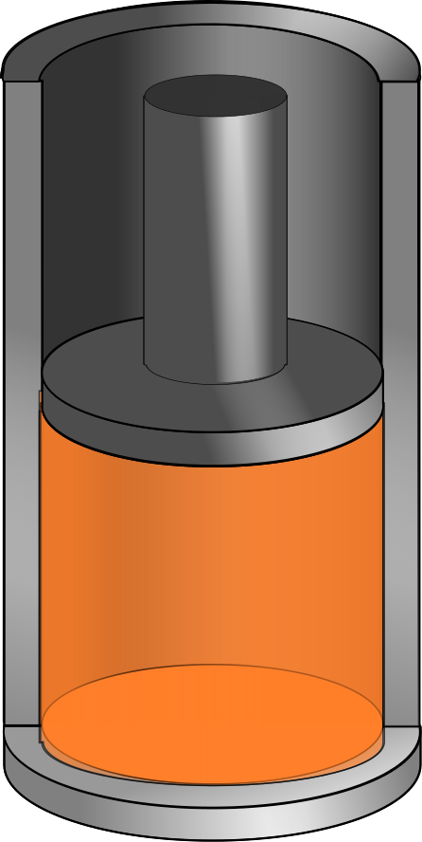
Work in a Gas Cylinder, cont.
A force is applied to slowly compress the gas
  The compression is slow enough for all the system to remain essentially in thermal equilibrium
W = - P ΔV
  This is the work done on the gas
Δy

Slide 51
More about Work on a Gas Cylinder
When the gas is compressed
  ΔV is negative
  The work done on the gas is positive
When the gas is allowed to expand
  ΔV is positive
  The work done on the gas is negative
When the volume remains constant
  No work is done on the gas

Slide 52
Notes about the Work Equation
The pressure remains constant during the expansion or compression
  This is called an isobaric process
If the pressure changes, the average pressure may be used to estimate the work done

Slide 53
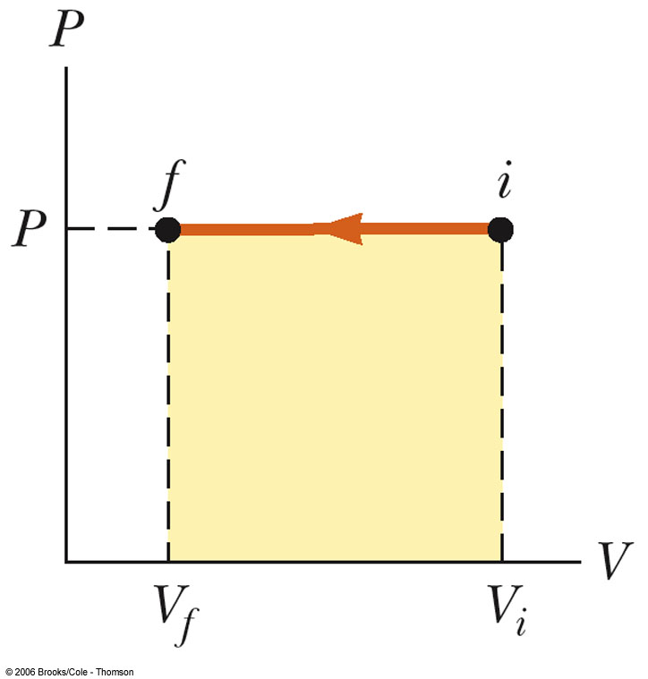
PV Diagrams
Used when the pressure and volume are known at each step of the process
The work done on a gas that takes it from some initial state to some final state is the negative of the area under the curve on the PV diagram
  This is true whether or not the pressure stays constant

Slide 54
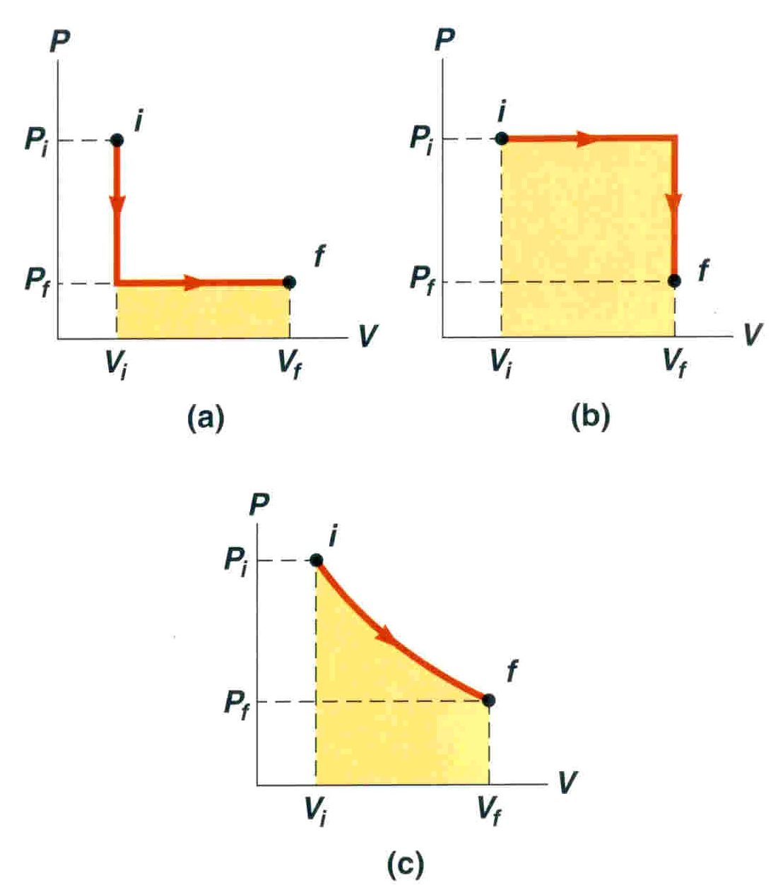
PV Diagrams, cont.
The curve on the diagram is called the path taken between the initial and final states
The work done depends on the particular path
  Same initial and final states, but different amounts of work are done

Slide 55





Summary
Specific Heat
Latent Heat

Slide 56
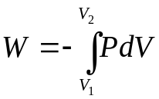
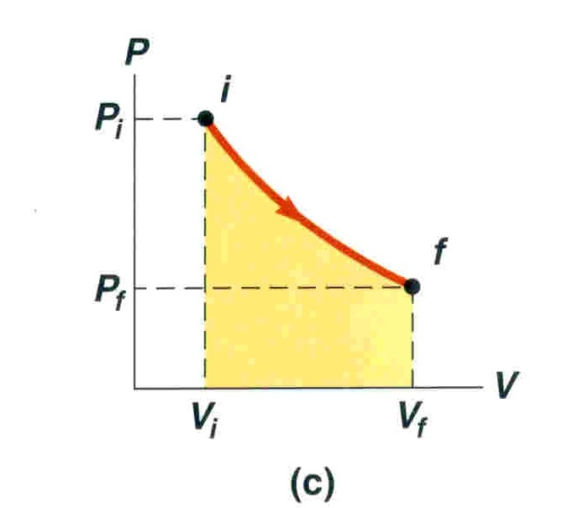
Summary
Work in Thermodynamic Processes
  PV diagrams
Problems to try 12-19
W = - P ΔV

